Slide 1
Optimal Emission Reduction
Internationally agreed targets
Cost-benefit analysis
Co-benefits

Slide 2
Lectures
Science
Scenarios & emission reduction options
Costs of emission reduction
Instruments for emission reduction
Impacts of climate change & adaptation
Economic impacts of climate change
Climate and development
Optimal emission reduction
Discounting, uncertainty, equity
International environmental agreements

Slide 3
Optimal Emission Reduction
Internationally agreed targets
Article 2, UNFCCC
The carbon cycle
Article 2, Paris Agreement
Cost-benefit analysis
Co-benefits

Slide 4
How deep?
The ultimate objective of [the United Nations Framework Convention on Climate Change] [...] is to achieve [...] stabilization of greenhouse gas concentrations in the atmosphere at a level that would prevent dangerous anthropogenic interference with the climate system. Such a level should be achieved within a time-frame sufficient to allow ecosystems to adapt naturally, to ensure that food production is not threatened and to enable economic development to proceed in a sustainable manner.

Slide 5
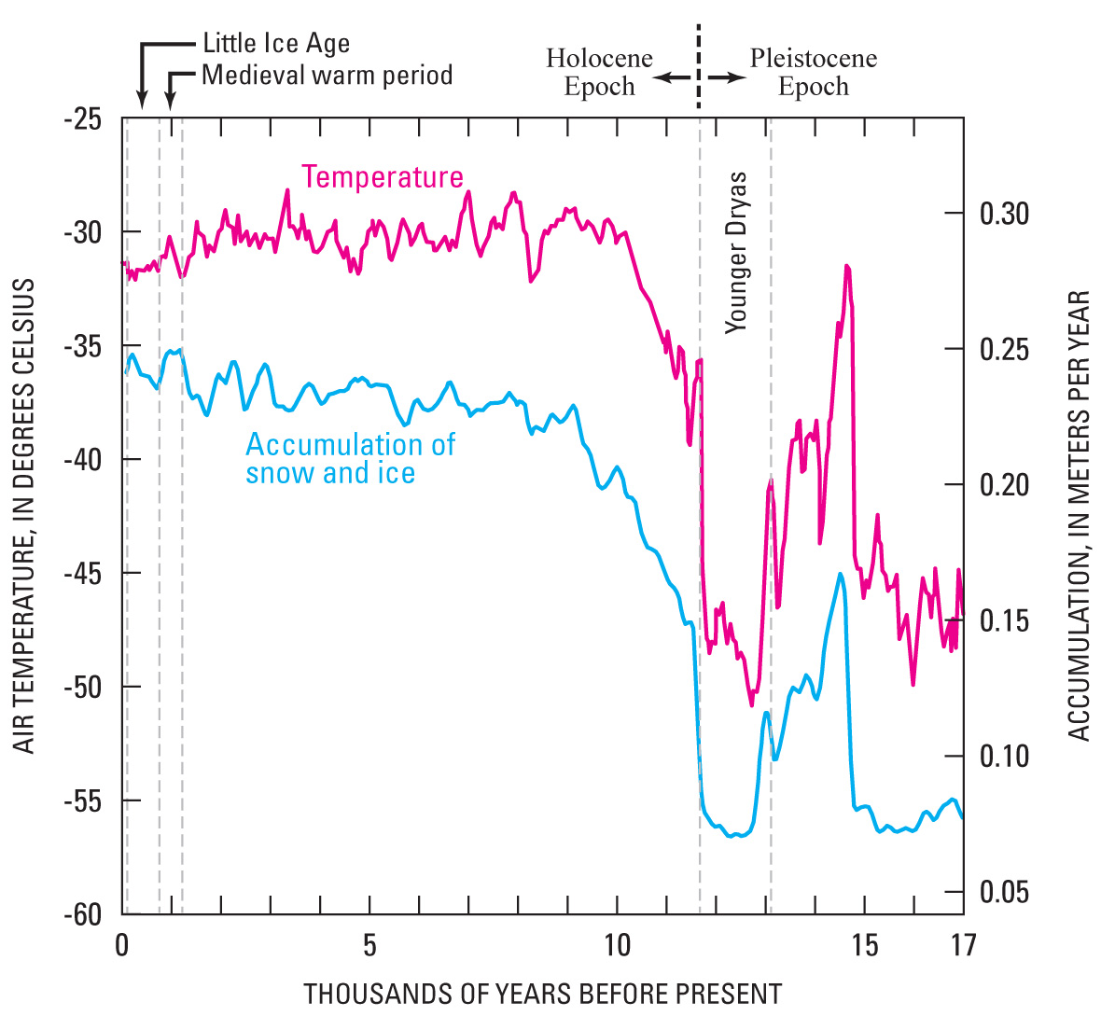

Slide 6
How deep?
The ultimate objective of [the United Nations Framework Convention on Climate Change] [...] is to achieve [...] stabilization of greenhouse gas concentrations in the atmosphere at a level that would prevent dangerous anthropogenic interference with the climate system. Such a level should be achieved within a time-frame sufficient to allow ecosystems to adapt naturally, to ensure that food production is not threatened and to enable economic development to proceed in a sustainable manner.

Slide 8
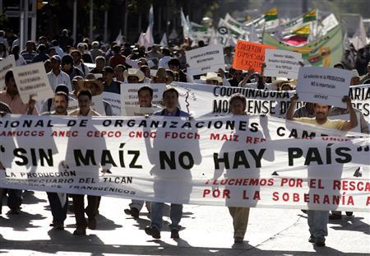

Slide 9
How deep?
The ultimate objective of [the United Nations Framework Convention on Climate Change] [...] is to achieve [...] stabilization of greenhouse gas concentrations in the atmosphere at a level that would prevent dangerous anthropogenic interference with the climate system. Such a level should be achieved within a time-frame sufficient to allow ecosystems to adapt naturally, to ensure that food production is not threatened and to enable economic development to proceed in a sustainable manner.

Slide 10
How deep?
The ultimate objective of [the United Nations Framework Convention on Climate Change] [...] is to achieve [...] stabilization of greenhouse gas concentrations in the atmosphere at a level that would prevent dangerous anthropogenic interference with the climate system. Such a level should be achieved within a time-frame sufficient to allow ecosystems to adapt naturally, to ensure that food production is not threatened and to enable economic development to proceed in a sustainable manner.

Slide 11

How deep?
Concentration
$$L_{t}=δL_{t−1}+M_{t−1} \\ \text{Stabilization}\text{: }L_{t}=L_{t−1}$$ L$=δL+M⇔L=\frac{M}{1−δ}$

Slide 12
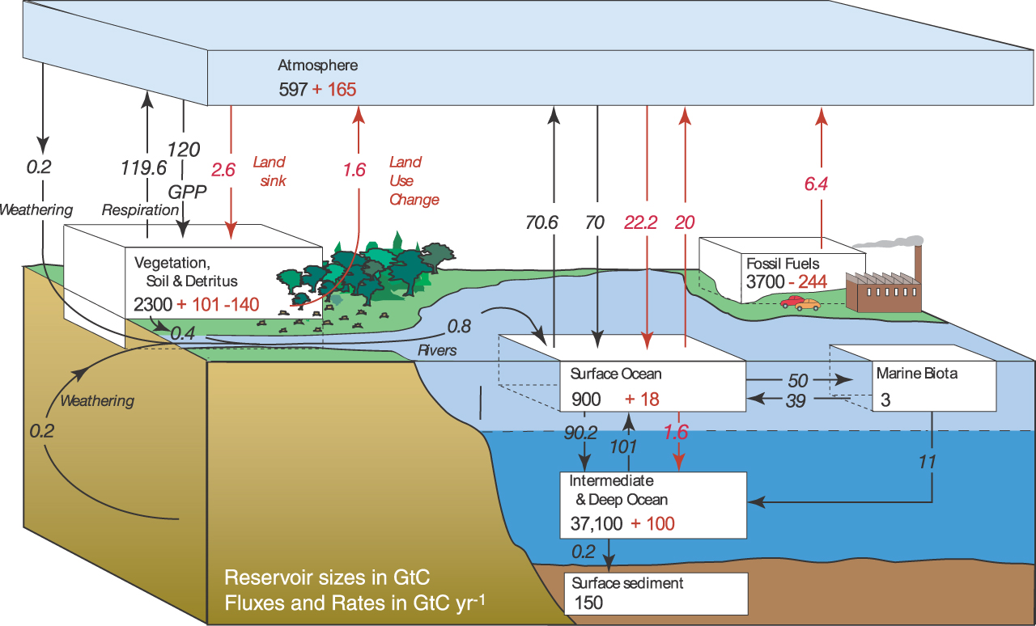

Slide 13
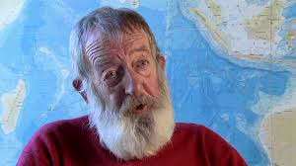
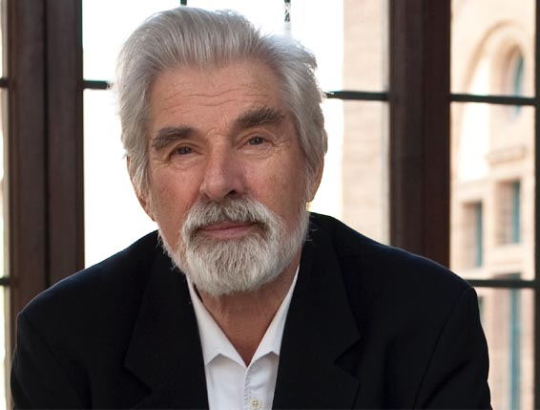


How deep?
Maier-Reimer & Hasselmann
$$L_{t}=\sum_{i=1}^{5}{L_{i,t}} \\ L_{i,t}=δ_{i}L_{i,t−1}+α_{i}M_{t−1};\sum_{i=1}^{5}{α_{i}}=1 \\ δ_{1}=1−1/2;δ_{2}=1−1/17;δ_{3}=1−1/74; \\ δ_{4}=1−1/363;δ_{5}=1$$
$$\text{Stabilization}\text{: }M=0$$
$$L_{t}=δL_{t−1}+M_{t−1} \\ \text{Stabilization}\text{: }L_{t}=L_{t−1}$$ L$=δL+M⇔L=\frac{M}{1−δ}$

Slide 14
How deep?
The ultimate objective of [the United Nations Framework Convention on Climate Change] [...] is to achieve [...] stabilization of greenhouse gas concentrations in the atmosphere at a level that would prevent dangerous anthropogenic interference with the climate system. Such a level should be achieved within a time-frame sufficient to allow ecosystems to adapt naturally, to ensure that food production is not threatened and to enable economic development to proceed in a sustainable manner.

Slide 15
2015 Paris Agreement, Art 2(1)a
This Agreement […] aims to strengthen the global response to the threat of climate change […] by […] [h]olding the increase in the global average temperature to well below 2°C above pre-industrial levels and pursuing efforts to limit the temperature increase to 1.5°C above pre-industrial levels, recognizing that this would significantly reduce the risks and impacts of climate change;

Slide 16
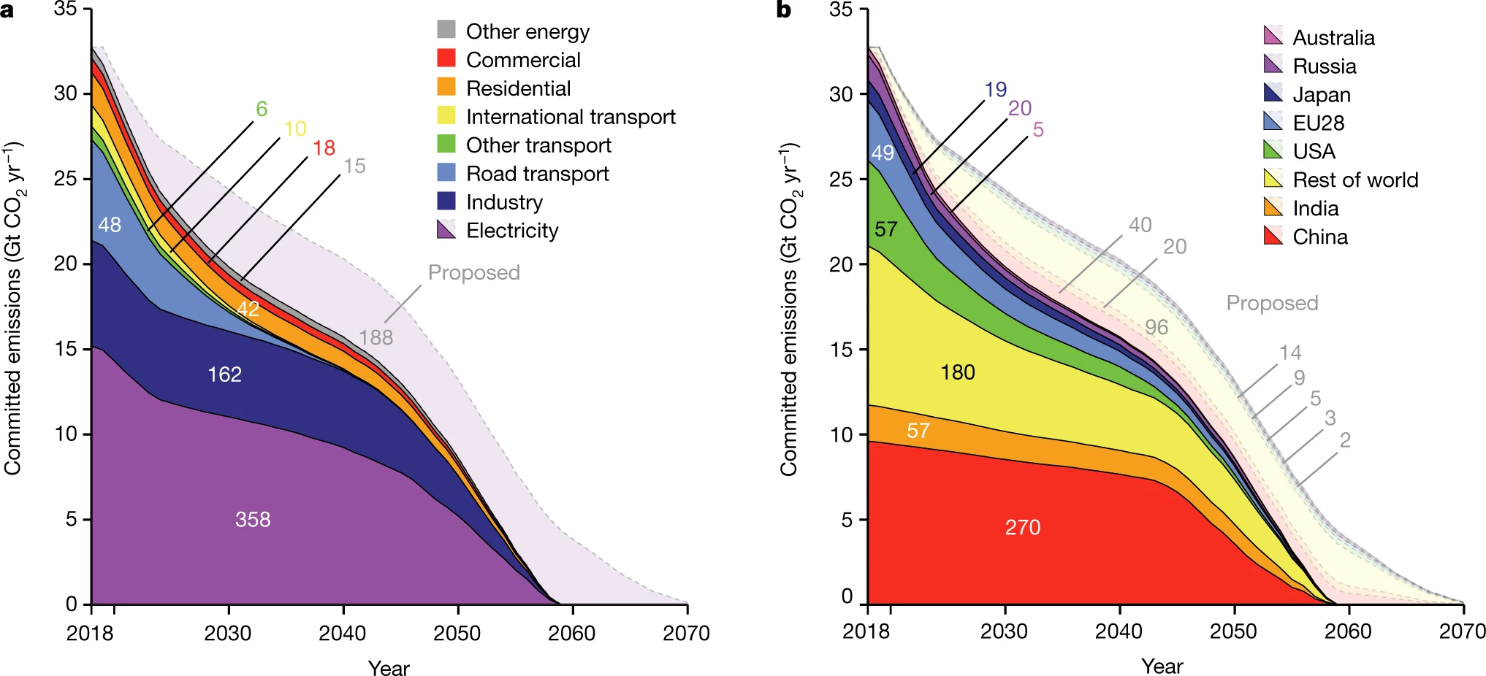
Committed emissions from existing and proposed energy infrastructure
(about 846 gigatonnes CO₂) thus represent more than the entire carbon
budget that remains if mean warming is to be limited to 1.5°C
with a probability of 66 to 50 per cent (420–580 gigatonnes CO₂),
and perhaps two-thirds of the remaining carbon budget if mean
warming is to be limited to less than 2 °C (1,170–1,500 gigatonnes CO₂).

Slide 17
Optimal Emission Reduction
Internationally agreed targets
Cost-benefit analysis
Recap of CBA
Orders of magnitude
Nordhaus’ DICE
Backstop
Co-benefits

Slide 22
Optimal Climate Policy
In a static optimum, the marginal costs should equal the marginal benefits

Slide 23

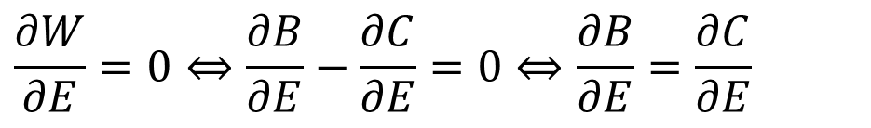
Optimal Climate Policy
In a static optimum, the marginal costs should equal the marginal benefits
$$\max_{E}W(E)=B(E)−C(E)$$
$$\frac{∂W}{∂E}=0⇔\frac{∂B}{∂E}−\frac{∂C}{∂E}=0⇔\frac{∂B}{∂E}=\frac{∂C}{∂E}$$

Slide 24
Optimal Climate Policy
In a static optimum, the marginal costs should equal the marginal benefits
In a situation like climate change, where the benefits are a stock and the costs are a flow, the marginal costs should equal the net present value of the marginal benefits

Slide 25
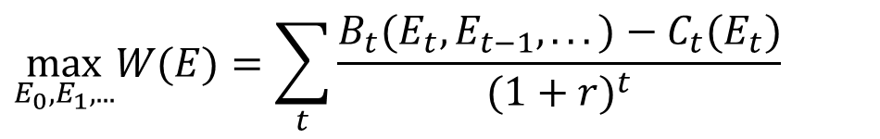
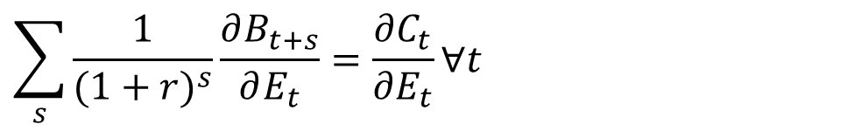
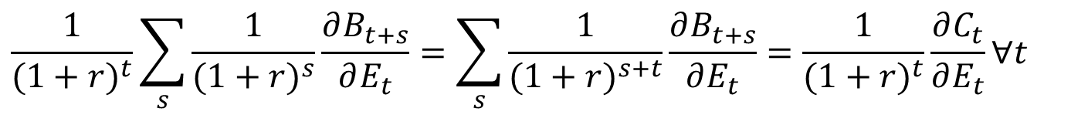
Optimal Climate Policy
In a situation like climate change, where the benefits are a stock and the costs are a flow, the marginal costs should equal the net present value of the marginal benefits
$$\max_{E_{0},E_{1},...}W(E)=\sum_{t}{\frac{B_{t}(E_{t},E_{t−1},...)−C_{t}(E_{t})}{(1+r)^{t}}}$$
$$\frac{1}{{(1+r)}^{t}}\sum_{s}{\frac{1}{(1+r)^{s}}\frac{∂B_{t+s}}{∂E_{t}}}=\sum_{s}{\frac{1}{(1+r)^{s+t}}\frac{∂B_{t+s}}{∂E_{t}}}=\frac{1}{{(1+r)}^{t}}\frac{∂C_{t}}{∂E_{t}}∀t$$
$$\sum_{s}{\frac{1}{(1+r)^{s}}\frac{∂B_{t+s}}{∂E_{t}}}=\frac{∂C_{t}}{∂E_{t}}∀t$$

Slide 28
Paris Agreement

Slide 29
Dynamic Integrated Climate Economy
That was a rough and ready cost-benefit analysis, equating marginal costs and benefits
Nobelist William D. Nordhaus of Yale U built the Dynamic Integrated Climate Economy (DICE) model, which couples a Solow-Swan model of economic growth to models of the carbon cycle and climate
DICE’ main application is to find optimal climate policy

Slide 32
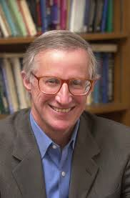
Optimal Emission Control
If the world were ruled by a benevolent dictator, what would she do?
A little emission reduction in the beginning, more later, but not enough to stabilise concentrations
The first part is robust, the second part is very sensitive to assumptions
The last part is robust, unless there is a cheap alternative to fossil fuels

Slide 34
Backstop
…unless there is a cheap alternative to fossil fuels
Carbon-free backstop = energy source
that does not emit CO2
that becomes competitive with fossil fuels at a finite carbon tax
that has such an abundant supply that it does not just compete at the margin, but also at market saturation
that continues to compete even if the carbon tax goes to zero

Slide 36
Optimal Emission Control
If the world were ruled by a benevolent dictator, what would she do?
A little emission reduction in the beginning, more later, but not enough to stabilise concentrations
The first part is robust, the second part is very sensitive to assumptions
The last part is robust, unless there is a cheap alternative to fossil fuels
If we consider many countries, optimal emission reduction goes down! (see final week)

Slide 37
Optimal Emission Reduction
Internationally agreed targets
Cost-benefit analysis
Co-benefits
Motivation
Independent policy
Interdependent policy

Slide 38
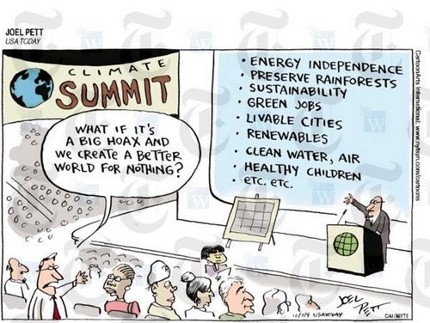

Slide 39




Two criterion emissions, G and A, measured as emission reductions.
Benefits, B, of emission reduction:
$$B=αA+χG$$
Emission controls, R and S, affect both:
$$G=πS+ρR$$
$$A=σS+τR$$
Costs, C, of emission reduction:
$$C=0.5κS^{2}+0.5λR^{2}$$
Rework benefits:
$$B=α\left(σS+τR\right)+χ\left(πS+ρR\right)=S\left(ασ+χπ\right)+R\left(ατ+χρ\right)$$

Slide 40

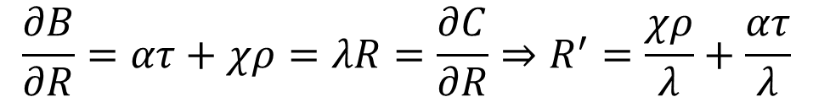
Benefits, B, of emission reduction:
$$B=α\left(σS+τR\right)+χ\left(πS+ρR\right)=S\left(ασ+χπ\right)+R\left(ατ+χρ\right)$$
Costs, C, of emission reduction:
$$C=0.5κS^{2}+0.5λR^{2}$$
Optimal control for R:
$$\frac{∂B}{∂R}=ατ+χρ=λR=\frac{∂C}{∂R}⇒R^{′}=\frac{χρ}{λ}+\frac{ατ}{λ}$$

Slide 41
Benefits, B, of emission reduction:
$$B=α\left(σS+τR\right)+χ\left(πS+ρR\right)=S\left(ασ+χπ\right)+R\left(ατ+χρ\right)$$
Costs, C, of emission reduction:
$$C=0.5κS^{2}+0.5λR^{2}$$
Optimal control for R:
$$\frac{∂B}{∂R}=ατ+χρ=λR=\frac{∂C}{∂R}⇒R^{′}=\frac{χρ}{λ}+\frac{ατ}{λ}$$
Optimal control for R equals
concern about climate times effect of climate policy on climate
over costs of climate policy
plus
concern about air pollution times effect of climate policy on air pollution
over costs of climate policy

Slide 43
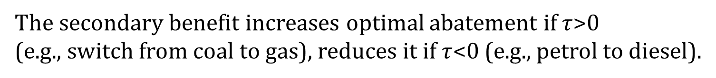
Benefits, B, of emission reduction:
$$B=α\left(σS+τR\right)+χ\left(πS+ρR\right)=S\left(ασ+χπ\right)+R\left(ατ+χρ\right)$$
Costs, C, of emission reduction:
$$C=0.5κS^{2}+0.5λR^{2}$$
Optimal control for R:
$$\frac{∂B}{∂R}=ατ+χρ=λR=\frac{∂C}{∂R}⇒R^{′}=\frac{χρ}{λ}+\frac{ατ}{λ}$$
The secondary benefit increases optimal abatement if $τ$>0
(e.g., switch from coal to gas), reduces it if $τ$<0 (e.g., petrol to diesel).

Slide 44
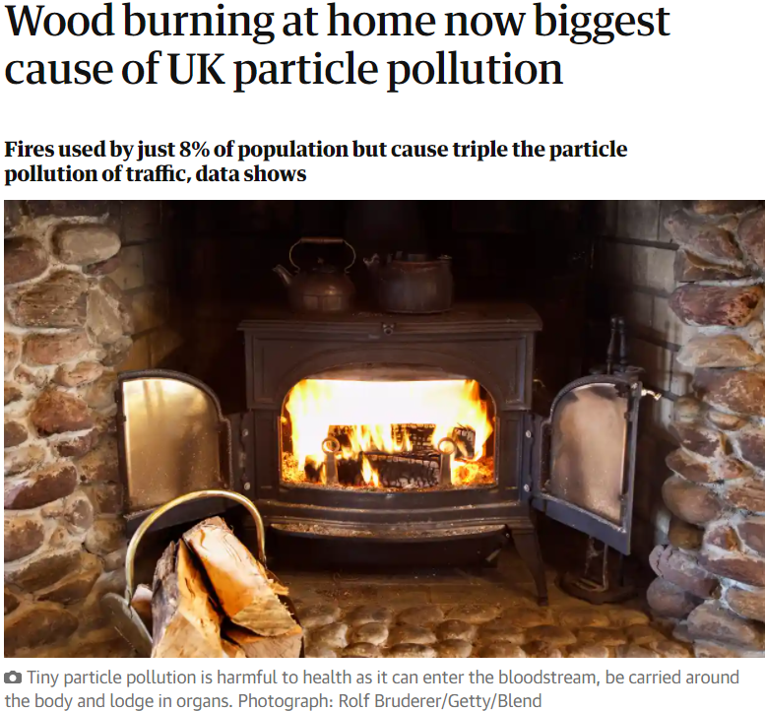
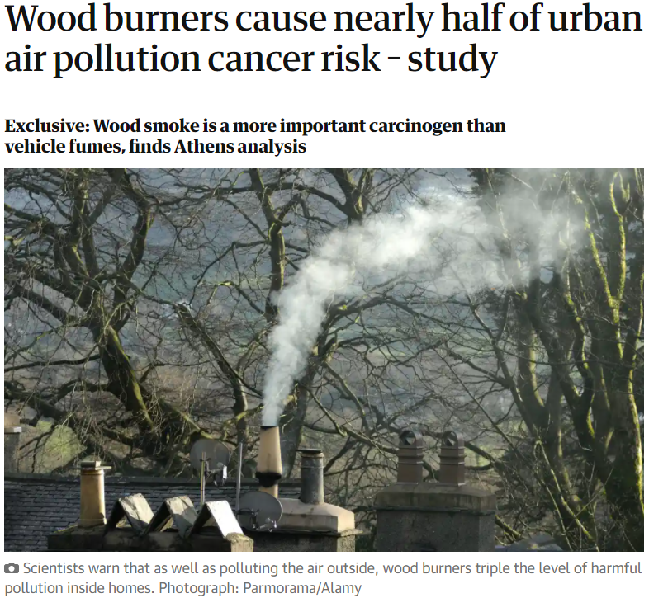

Slide 45
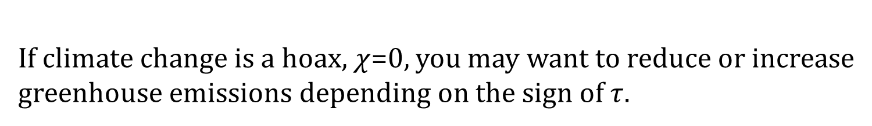
Benefits, B, of emission reduction:
$$B=α\left(σS+τR\right)+χ\left(πS+ρR\right)=S\left(ασ+χπ\right)+R\left(ατ+χρ\right)$$
Costs, C, of emission reduction:
$$C=0.5κS^{2}+0.5λR^{2}$$
Optimal control for R:
$$\frac{∂B}{∂R}=ατ+χρ=λR=\frac{∂C}{∂R}⇒R^{′}=\frac{χρ}{λ}+\frac{ατ}{λ}$$
The secondary benefit increases optimal abatement if $τ$>0
(e.g., switch from coal to gas), reduces it if $τ$<0 (e.g., petrol to diesel).
If climate change is a hoax, $χ$=0, you may want to reduce or increase
greenhouse emissions depending on the sign of $τ$.

Slide 46
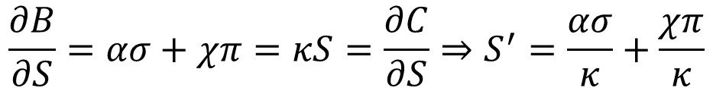
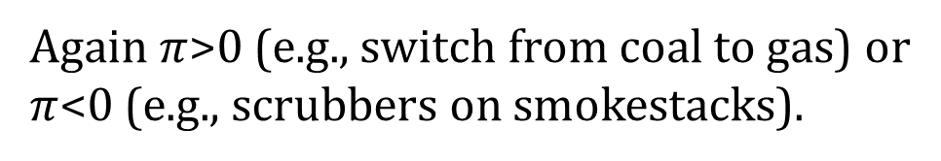
Optimal control for S:
$$\frac{∂B}{∂S}=ασ+χπ=κS=\frac{∂C}{∂S}⇒S^{′}=\frac{ασ}{κ}+\frac{χπ}{κ}$$
Again $π$>0 (e.g., switch from coal to gas) or
$π$<0 (e.g., scrubbers on smokestacks).

Slide 47
Secondary benefits
If greenhouse gas emission reduction helps solving other problems (air pollution, energy security), then we should do more of it, but it can also make these problems worse

Slide 48


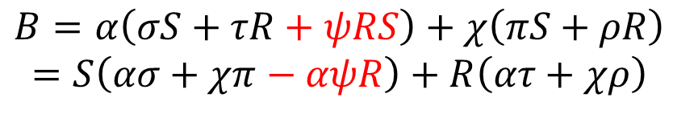

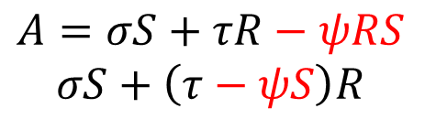
Now make the secondary benefits less than linear.
Benefits, B, of emission reduction:
$$B=αA+χG$$
Emission controls, R and S, affect both:
$$G=πS+ρR$$
$$A=σS+τR−ψRS$$
$$σS+\left(τ−ψS\right)R$$
Costs, C, of emission reduction:
$$C=0.5κS^{2}+0.5λR^{2}$$
Rework benefits:
$$B=α\left(σS+τR+ψRS\right)+χ\left(πS+ρR\right)$$
$$=S\left(ασ+χπ−αψR\right)+R\left(ατ+χρ\right)$$

Slide 49

Benefits, B, of emission reduction:
$$B=α\left(σS+τR−ψRS\right)+χ\left(πS+ρR\right)$$
Costs, C, of emission reduction:
$$C=0.5κS^{2}+0.5λR^{2}$$
Optimal control for R:
$$\frac{∂B}{∂R}=ατ+χρ−αψS=λR=\frac{∂C}{∂R}⇒R=\frac{ατ+χρ}{λ}−\frac{αψ}{λ}S$$
$$\frac{∂B}{∂S}=ασ+χπ−αψR=κS=\frac{∂C}{∂S}⇒S=\frac{ασ+χπ}{κ}−\frac{αψ}{κ}R$$

Slide 51

Benefits, B, of emission reduction:
$$B=α\left(σS+τR−ψRS\right)+χ\left(πS+ρR\right)$$
Costs, C, of emission reduction:
$$C=0.5κS^{2}+0.5λR^{2}$$
Optimal control for R:
$$\frac{∂B}{∂R}=ατ+χρ−αψS=λR=\frac{∂C}{∂R}⇒R=\frac{ατ+χρ}{λ}−\frac{αψ}{λ}S$$
$$\frac{∂B}{∂S}=ασ+χπ−αψR=κS=\frac{∂C}{∂S}⇒S=\frac{ασ+χπ}{κ}−\frac{αψ}{κ}R$$
$$R^{′}=\frac{\left(ατ+χρ\right)κ−(ασ+χπ)αψ}{λκ−{α^{2}ψ}^{2}}$$

Slide 52
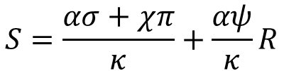
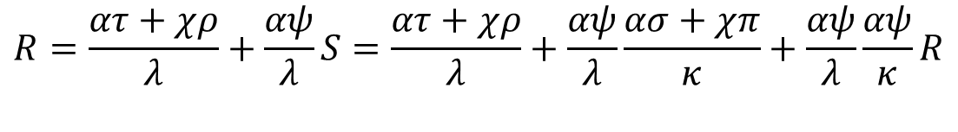
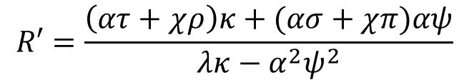
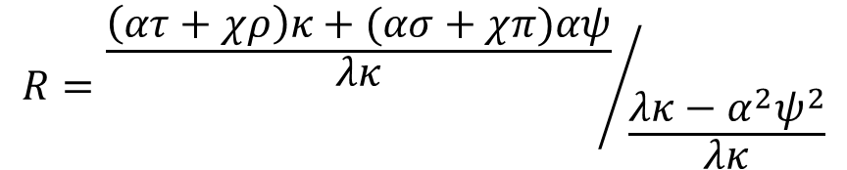
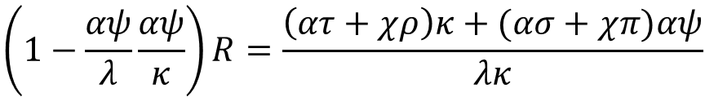
$$S=\frac{ασ+χπ}{κ}+\frac{αψ}{κ}R$$
$$R=\frac{ατ+χρ}{λ}+\frac{αψ}{λ}S=\frac{ατ+χρ}{λ}+\frac{αψ}{λ}\frac{ασ+χπ}{κ}+\frac{αψ}{λ}\frac{αψ}{κ}R$$
$$\left(1−\frac{αψ}{λ}\frac{αψ}{κ}\right)R=\frac{\left(ατ+χρ\right)κ+(ασ+χπ)αψ}{λκ}$$
$$R={\frac{\left(ατ+χρ\right)κ+(ασ+χπ)αψ}{λκ}}/{\frac{λκ−α^{2}ψ^{2}}{λκ}}$$
$$R′=\frac{\left(ατ+χρ\right)κ+(ασ+χπ)αψ}{λκ−α^{2}ψ^{2}}$$

Slide 53
Two effects:
-Air pollution policy takes away some
of the secondary benefit;
-There is a reduction in the cost of
climate policy, as the cost is shifted
to air pollution policy.

Slide 54
Secondary benefits
If greenhouse gas emission reduction helps solving other problems (air pollution, energy security), then we should do more of it, but it can also make these problems worse
Secondary benefits shrink with policies aimed at these problems

